Slide 1

Computational Physics (PHYS6350)
Lecture 16: Partial Differential Equations Part II
Initial value problems
Heat equation
Wave equation
Reference: Chapter 9 of Computational Physics by Mark Newman
Instructor: Volodymyr Vovchenko (vvovchenko@uh.edu)
Course materials: https://github.com/vlvovch/PHYS6350-ComputationalPhysics
Online textbook: https://vovchenko.net/computational-physics/

Slide 2
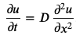
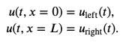
Initial value problem in PDEs
Many PDEs describe time evolution of fields u(t,x)
For example heat equation describing the temperature profile
This equation describes the time evolution of u(t,x) given initial profile
and boundary conditions
If boundary conditions are static, the solution will approach a stationary profile at large times

Slide 3
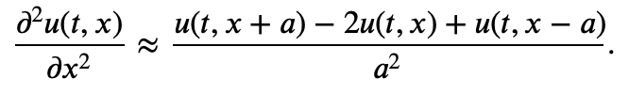
Finite difference approach to heat equation
First, one discretizes the spatial coordinate into a grid with N+1 points, i.e.
The spatial 2nd derivative is approximate with central difference
How to discretize time derivative?
Three common options:
FTCS scheme
Implicit scheme
Crank-Nicolson method

Slide 4
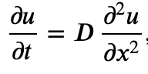
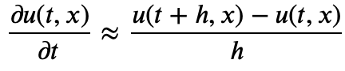
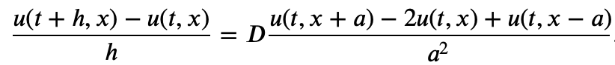
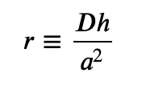
Finite difference approach to heat equation: FTCS scheme
FTCS (Forward Time Centered Space) scheme
Time derivative approximated by forward difference
This gives the following discretized PDE
The method is explicit: to evaluate u(t+h,x) one only needs u(t,x) at the present time
Discretized form

Slide 5
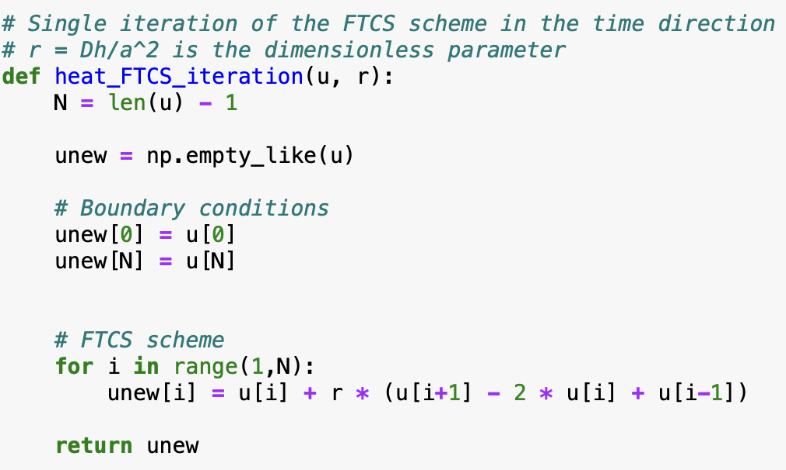
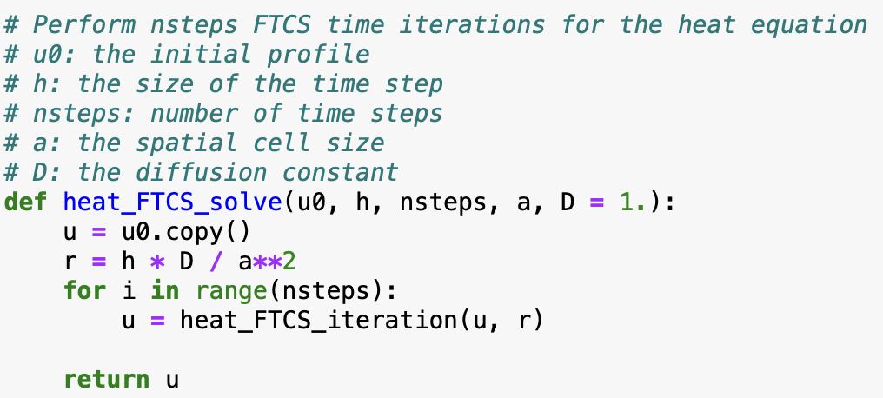
FTCS scheme for heat equation

Slide 6
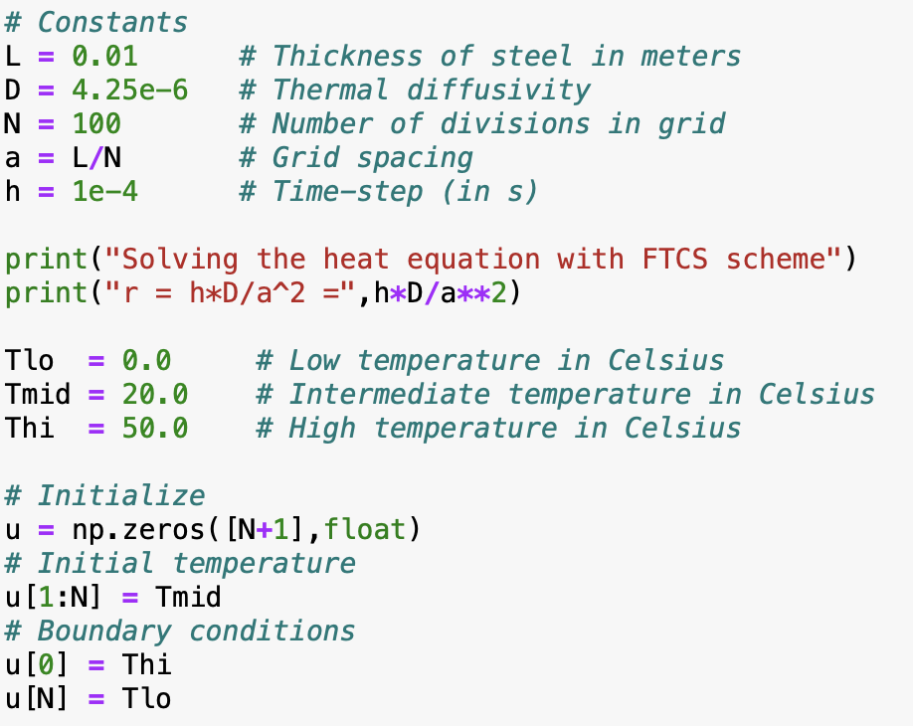
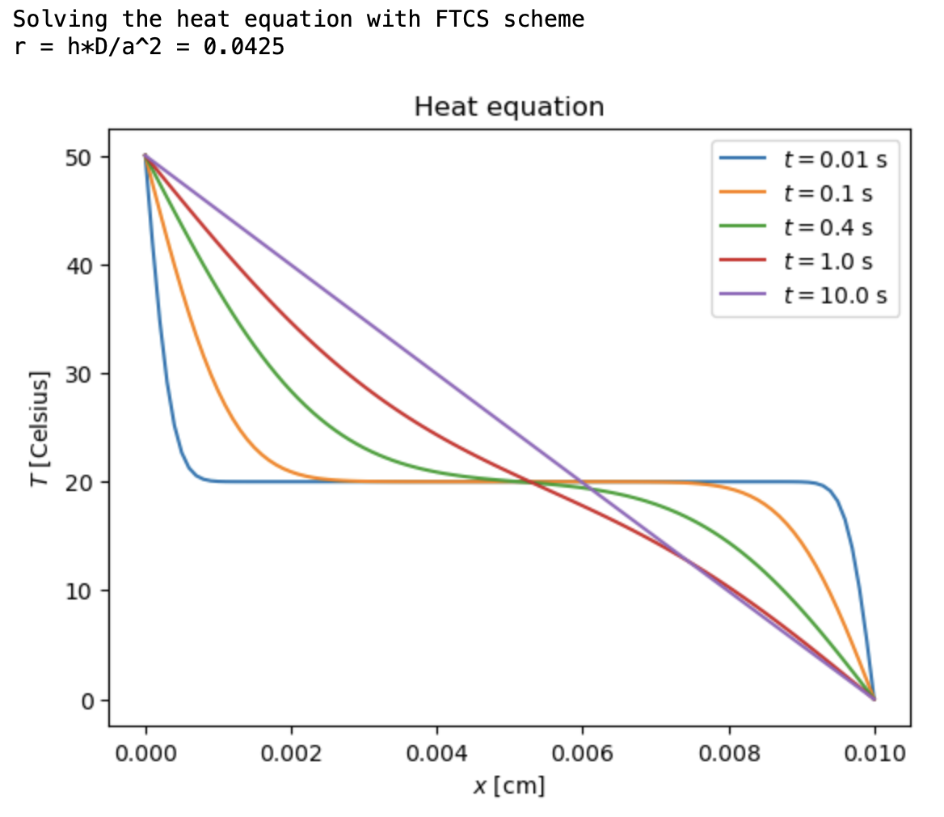
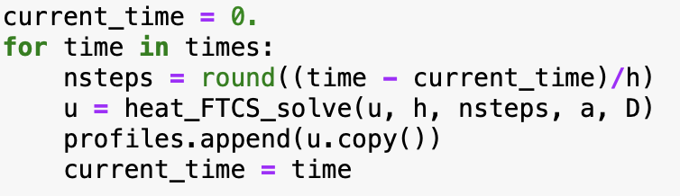
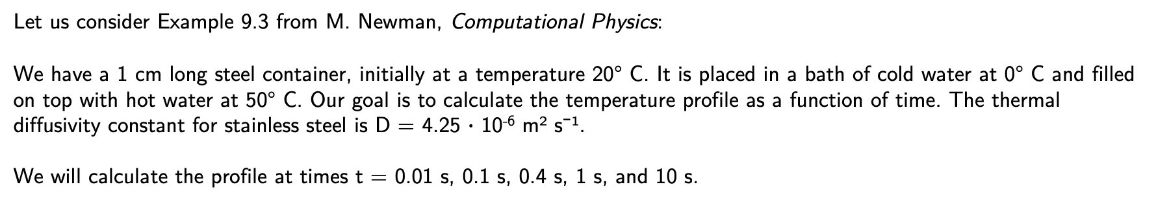
Example
Let us consider Example 9.3 from M. Newman, Computational Physics:
We have a 1 cm long steel container, initially at a temperature 20° C. It is placed in a bath of cold water at 0° C and filled on top with hot water at 50° C. Our goal is to calculate the temperature profile as a function of time. The thermal diffusivity constant for stainless steel is D = 4.25 $∙$ 10⁻⁶ m² s⁻¹.
We will calculate the profile at times t = 0.01 s, 0.1 s, 0.4 s, 1 s, and 10 s.

Slide 7
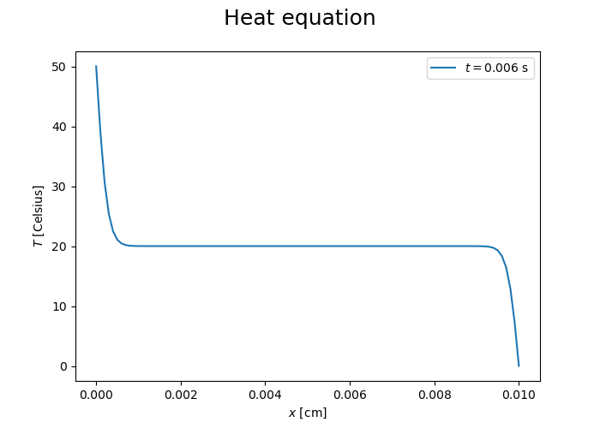
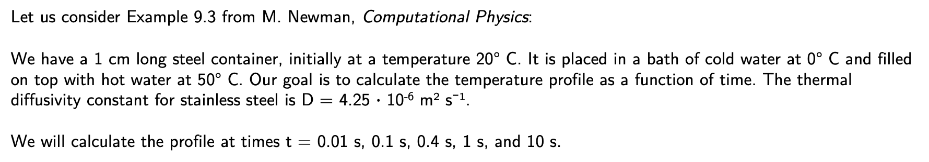
Animation
Let us consider Example 9.3 from M. Newman, Computational Physics:
We have a 1 cm long steel container, initially at a temperature 20° C. It is placed in a bath of cold water at 0° C and filled on top with hot water at 50° C. Our goal is to calculate the temperature profile as a function of time. The thermal diffusivity constant for stainless steel is D = 4.25 $∙$ 10⁻⁶ m² s⁻¹.
We will calculate the profile at times t = 0.01 s, 0.1 s, 0.4 s, 1 s, and 10 s.

Slide 8
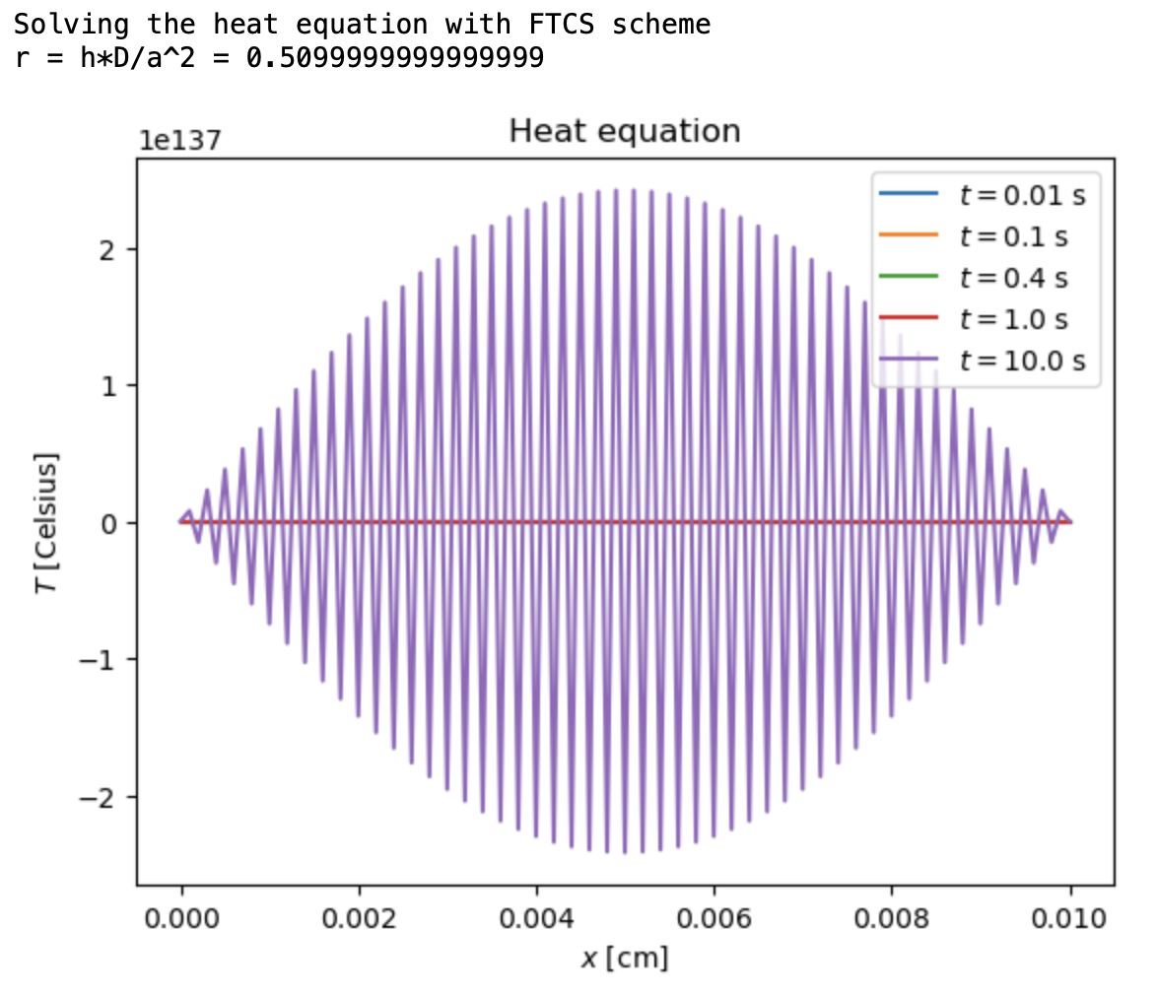
Try a larger time step
The method is unstable if r > 0.5

Slide 9
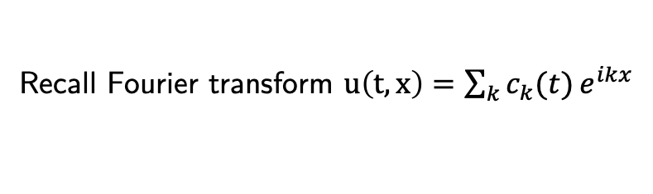
Stability analysis: Neumann method
Recall Fourier transform $u\left(t,x\right)=\sum_{k}{c_{k}(t)}e^{ikx}$
Analyze the following solutions: $u\left(t,x\right)=c_{k}(t)e^{ikx}$
Plugging into
one gets
i.e.
The method is stable if r<1/2

Slide 10
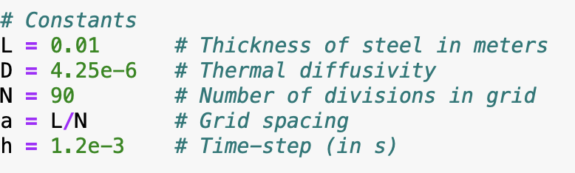
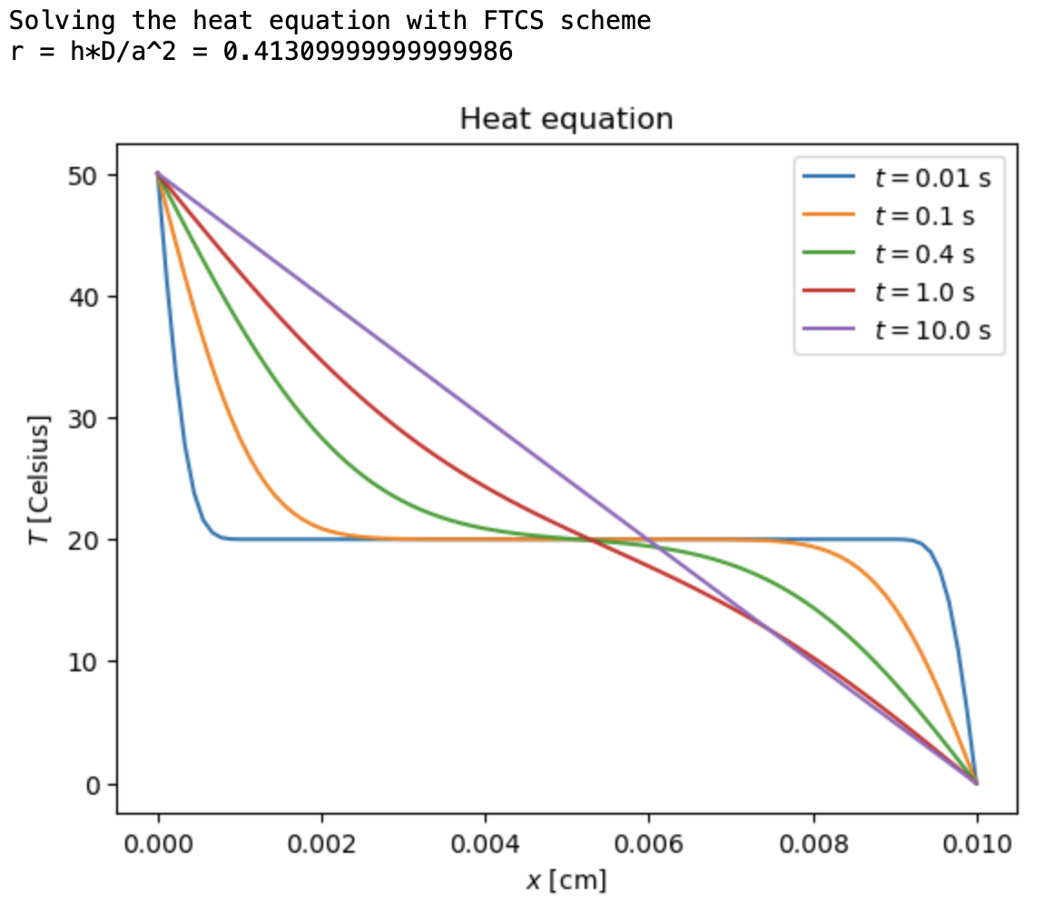
Try a larger space step to compensate for large time step

Slide 11
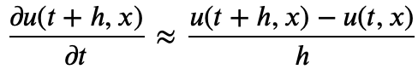
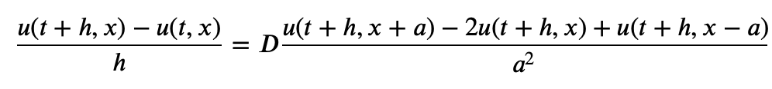
Implicit scheme
Time derivative approximated by backward difference
This gives the following discretized PDE
Discretized form
Tridiagonal system of linear equations at each step
Neumann stability analysis: method is stable for any r

Slide 12
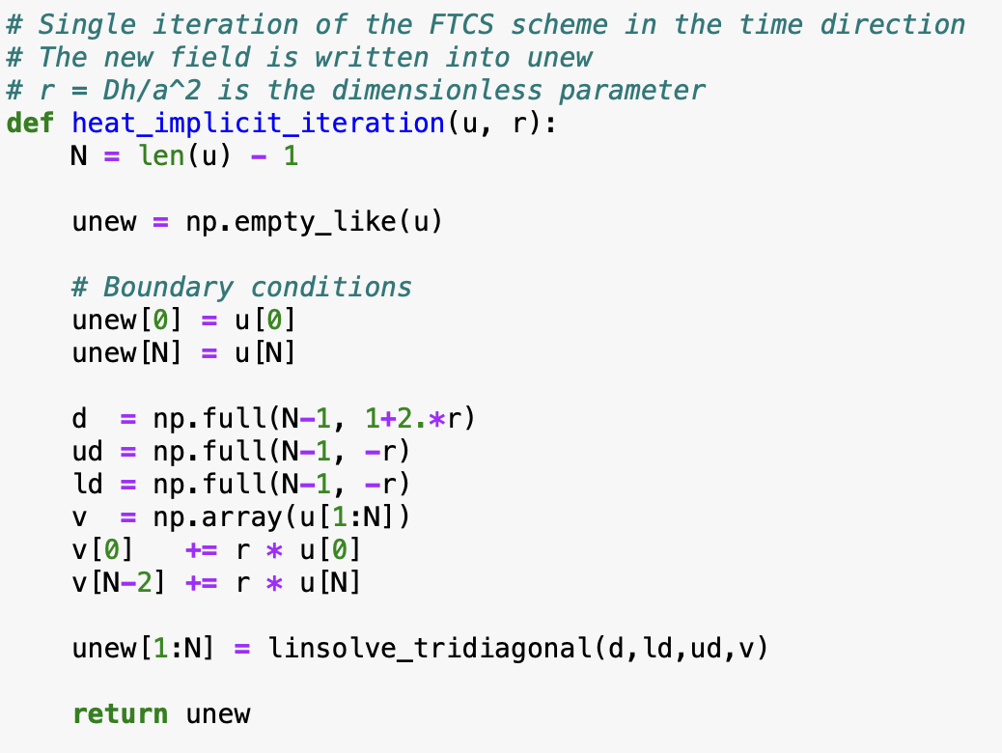
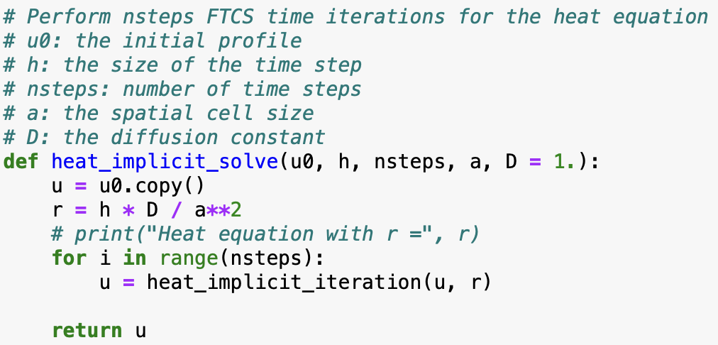
Implicit scheme for heat equation

Slide 13
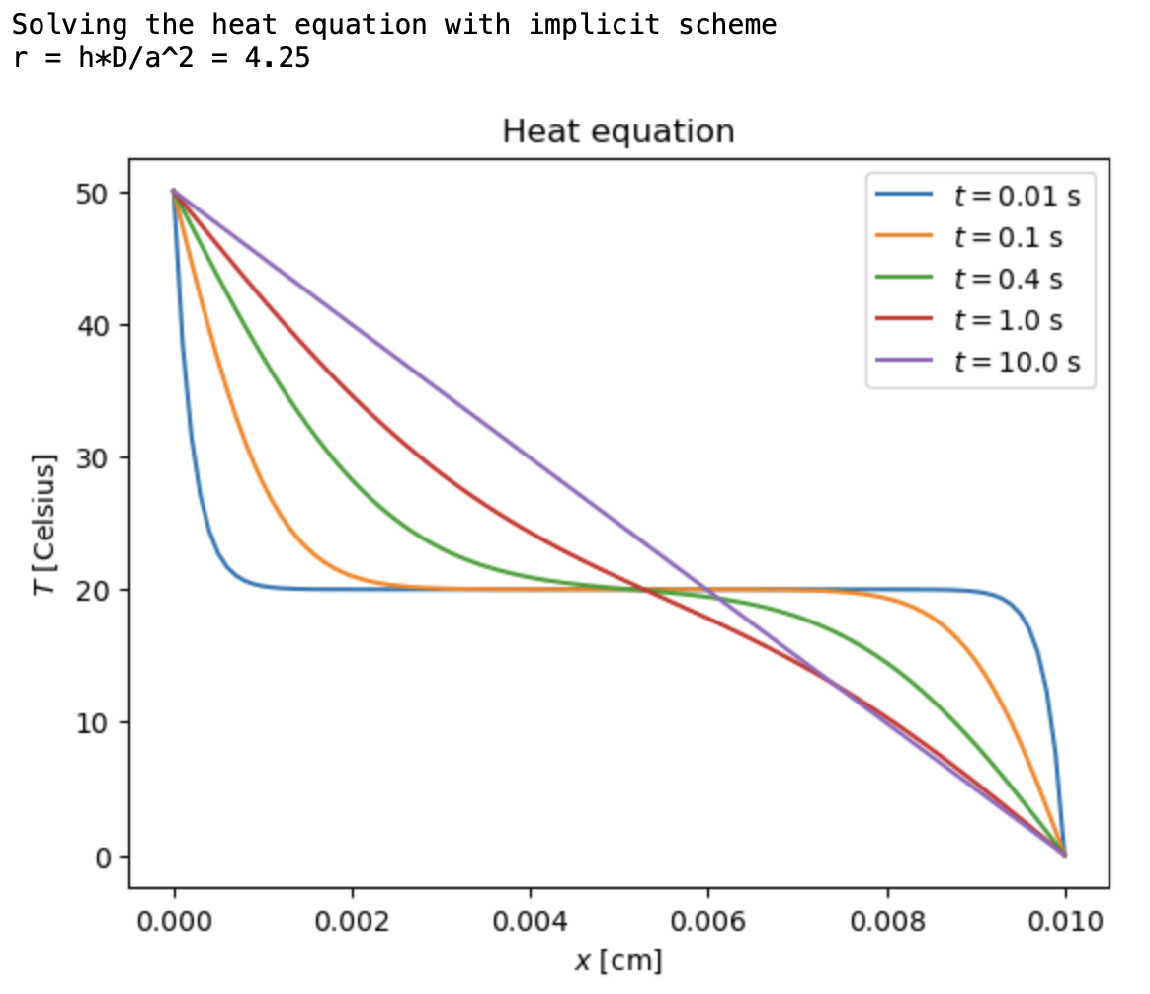
Implicit scheme: large time step

Slide 14
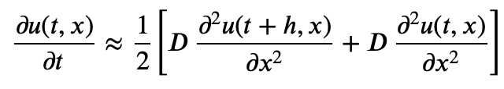
Crank-Nicolson scheme
“Average” between forward and backward difference
Essentially a trapezoidal rule for the time integration (more accurate than forward/backward differences)
Discretized form
Tridiagonal system of linear equations at each step:
Neumann stability analysis: method is stable for any r

Slide 15
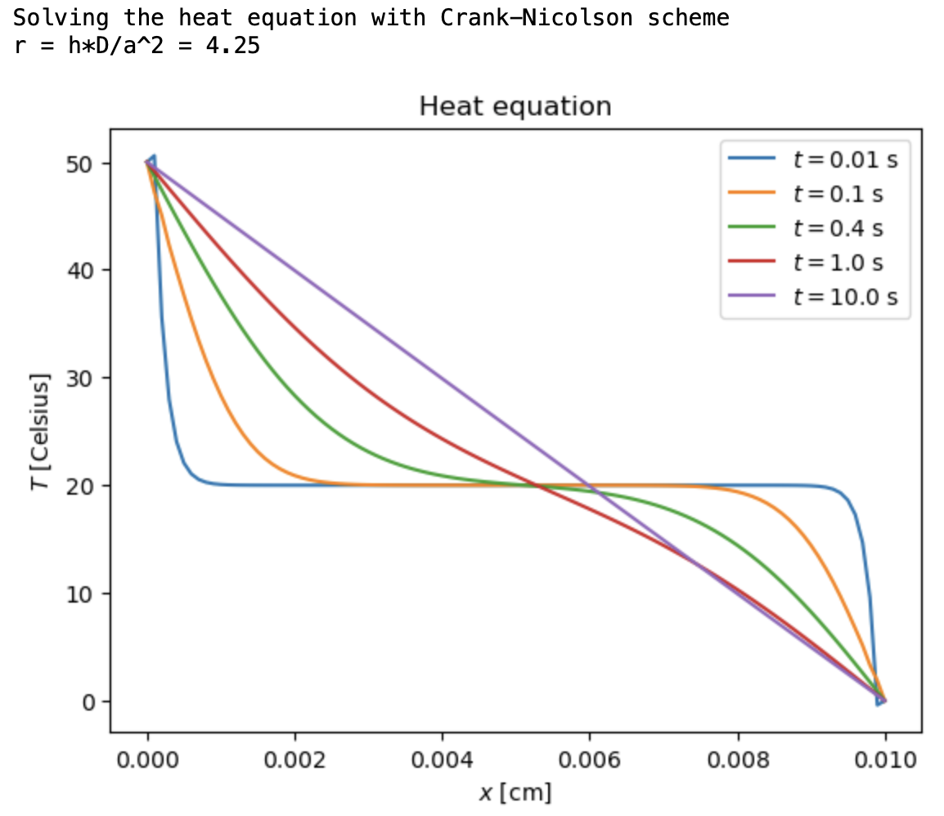
Crank-Nicolson scheme: large time step

Slide 16
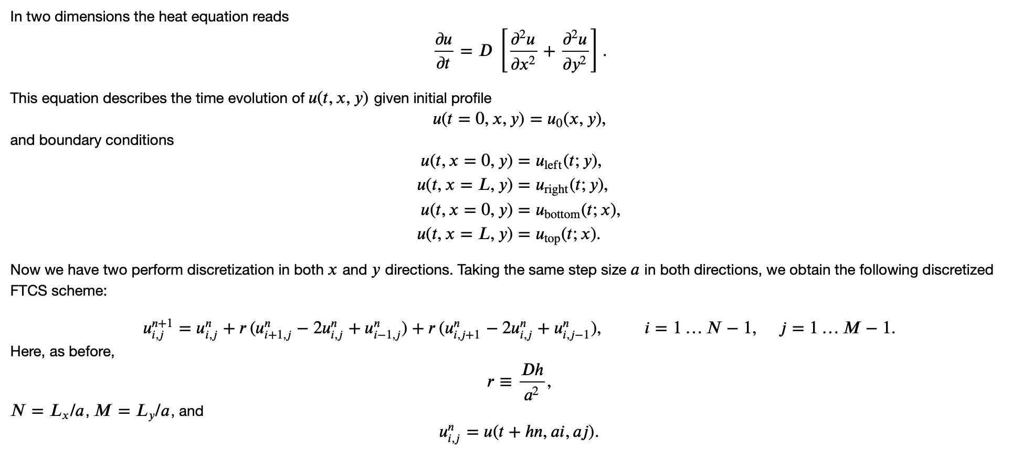
Heat equation in two dimensions

Slide 17
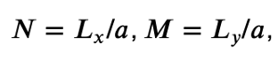
Heat equation in two dimensions
In two dimensions, the heat equation reads:
This equation describes the time evolution of u(t, x, y) given the initial profile and boundary conditions:
Now, we perform discretization in both x and y directions. Taking the same step size a in both directions, we obtain the following discretized FTCS scheme:
Here, as before:
and

Slide 18
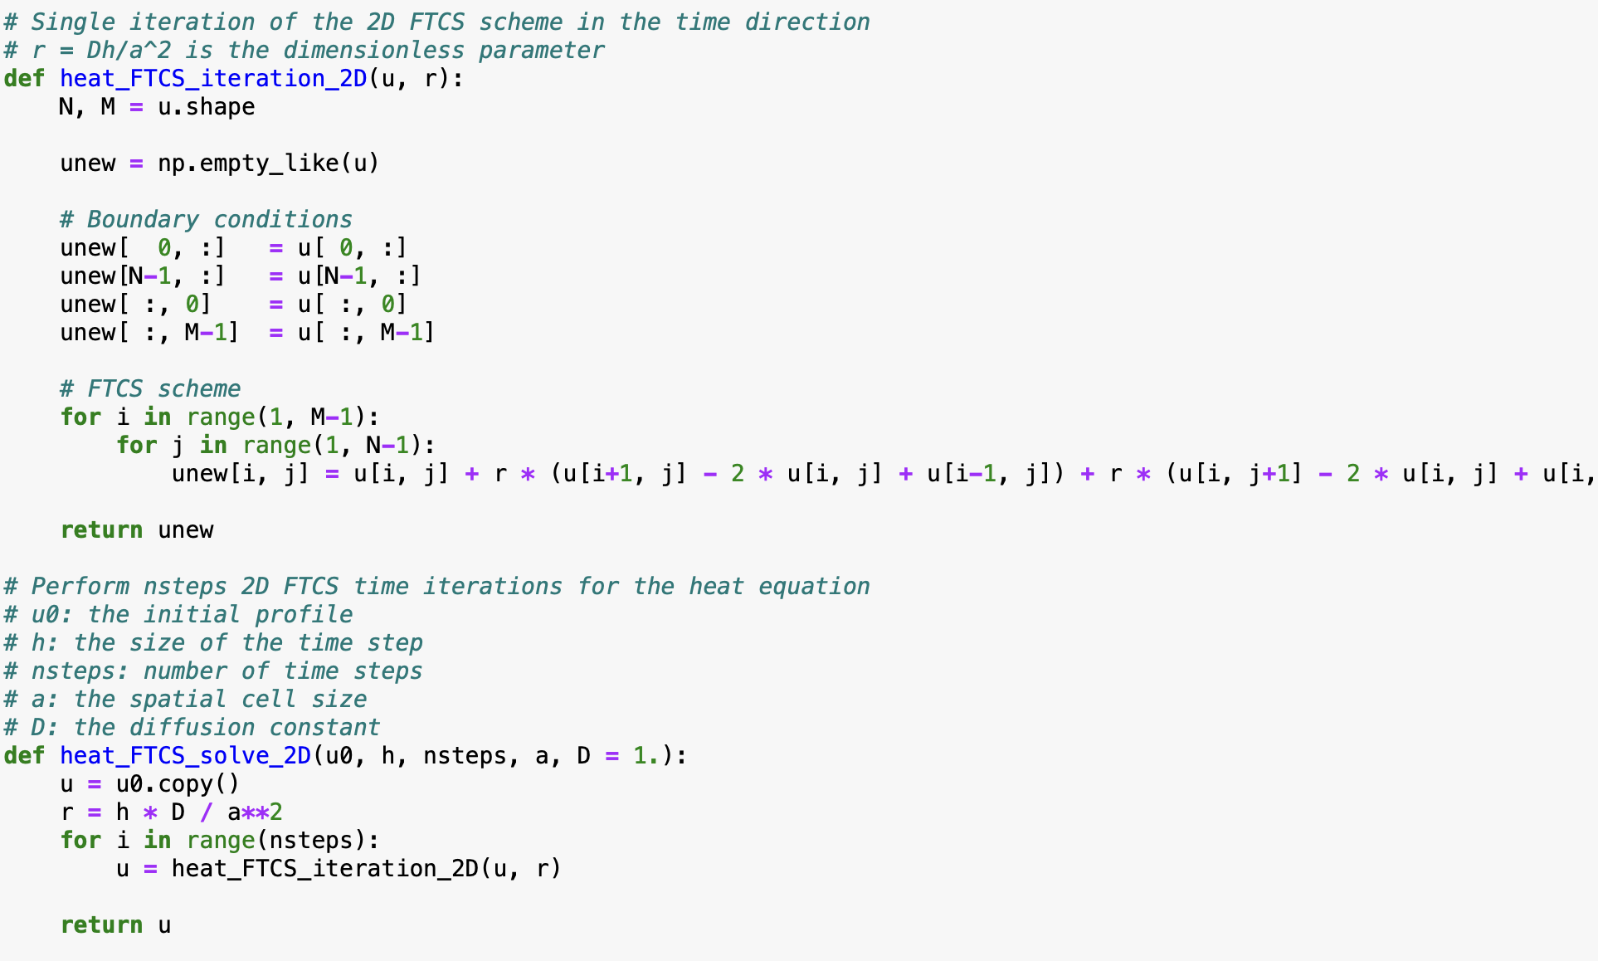
Heat equation in two dimensions: FTCS scheme

Slide 19
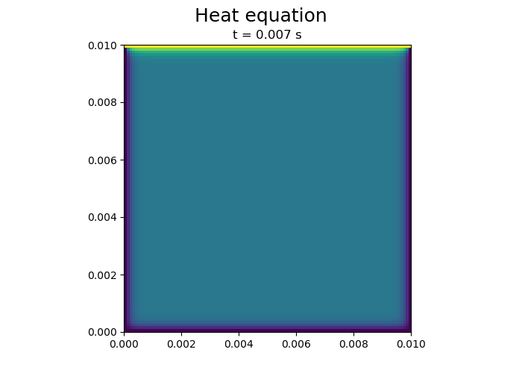
Heat equation in two dimensions: FTCS scheme

Slide 20
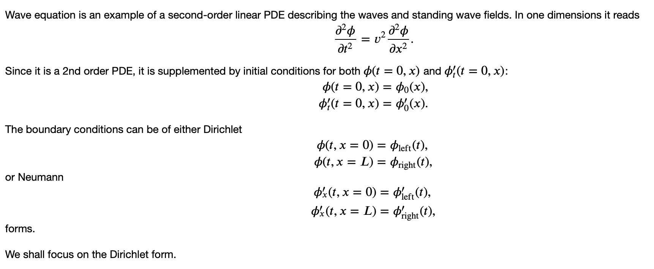
Wave equation

Slide 21
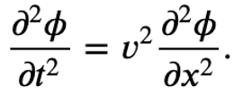
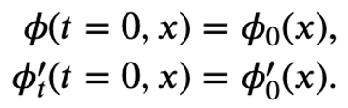
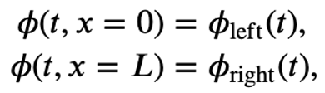
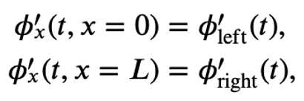
Wave equation
The wave equation is an example of a second-order linear PDE describing waves and standing wave fields. In one dimension, it reads:
wave equation
Since it is a second-order PDE, it is supplemented by initial conditions for both $φ(t = 0, x)$ and $φ_{t}^{′} (t = 0, x)$:
initial conditions
The boundary conditions can be either Dirichlet,
boundary conditions (Dirichlet)
or Neumann,
boundary conditions (Neumann)
We shall focus on the Dirichlet form.

Slide 22
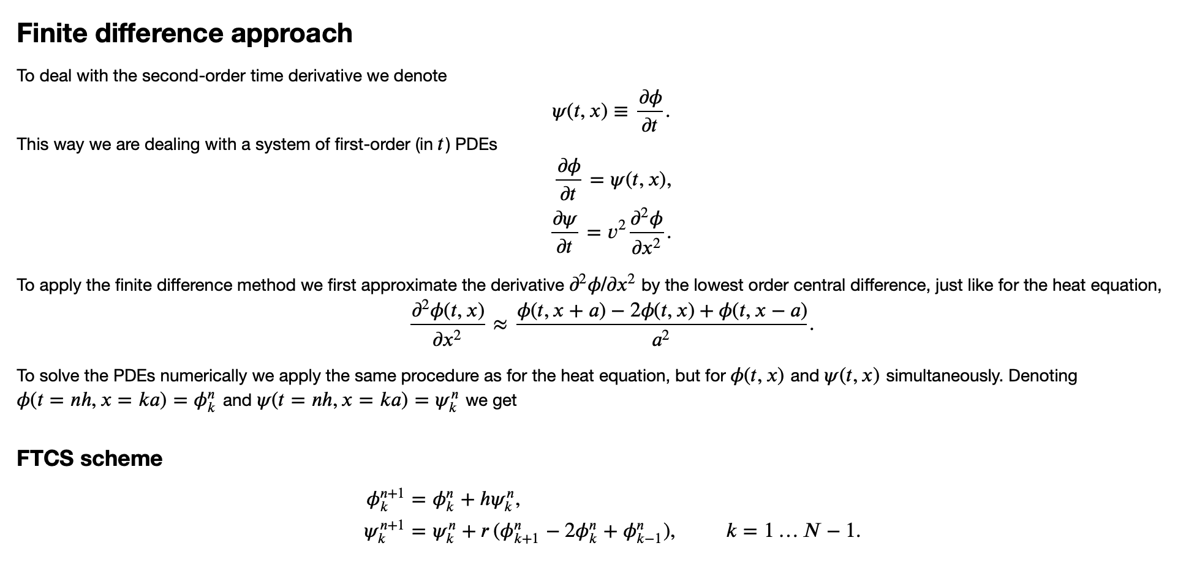
Finite difference approach

Slide 23
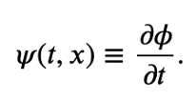
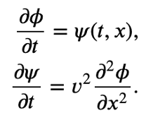
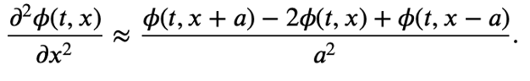
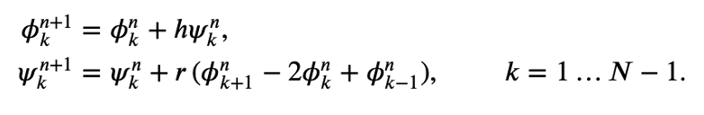
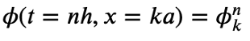
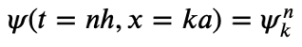
Finite difference approach
Finite Difference Approach
To deal with the second-order time derivative, we denote:
This way, we are dealing with a system of first-order (in t) PDEs:
To apply the finite difference method, we first approximate the derivative $∂^{2}φ/∂x^{2}$ by the lowest-order central difference, just like for the heat equation:
To solve the PDEs numerically, we apply the same procedure as for the heat equation, but for $φ(t, x)$ and $ψ(t, x)$ simultaneously.
FTCS scheme:

Slide 24
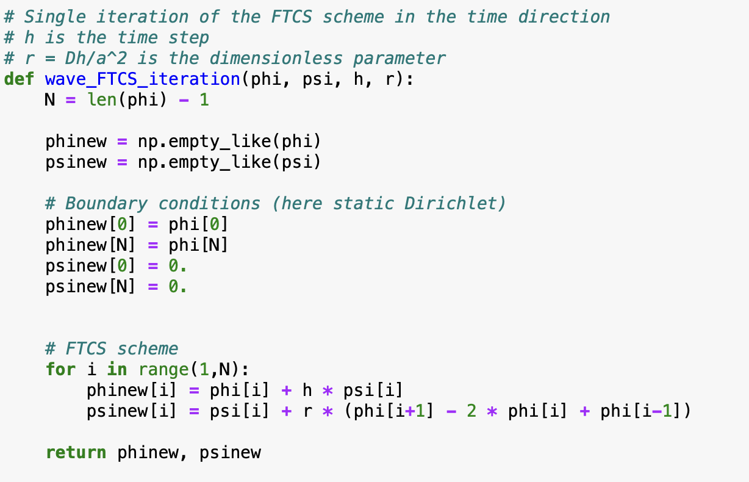
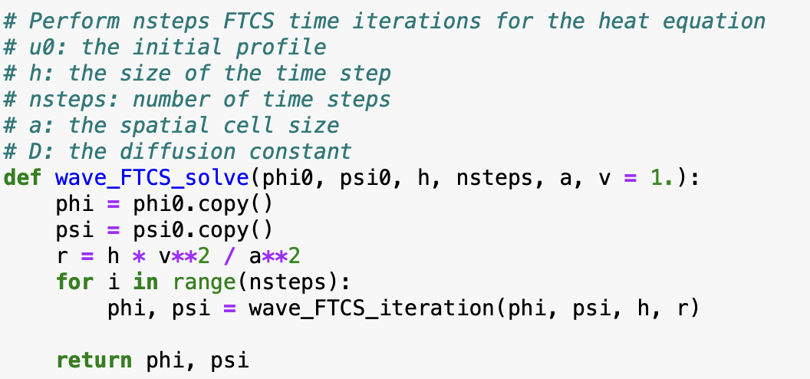
Wave equation

Slide 25
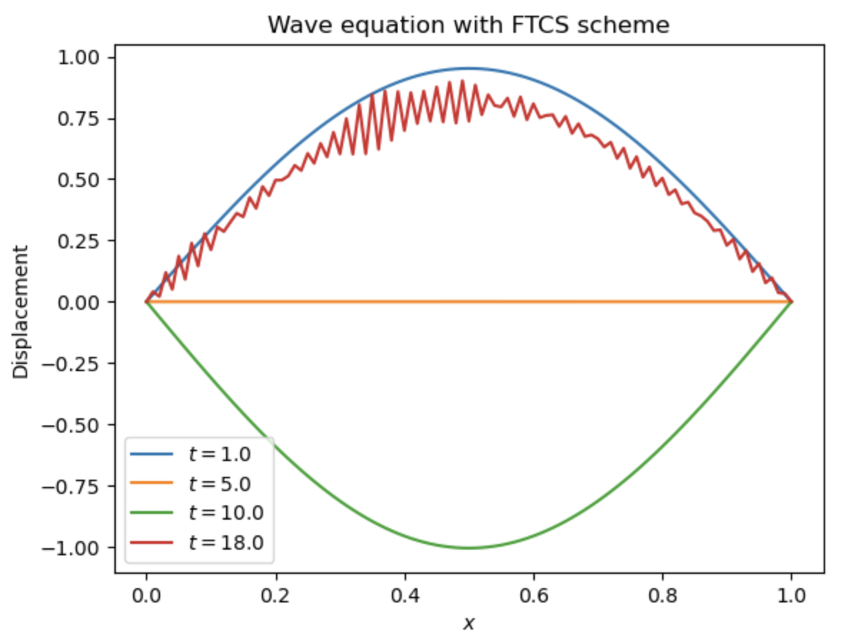
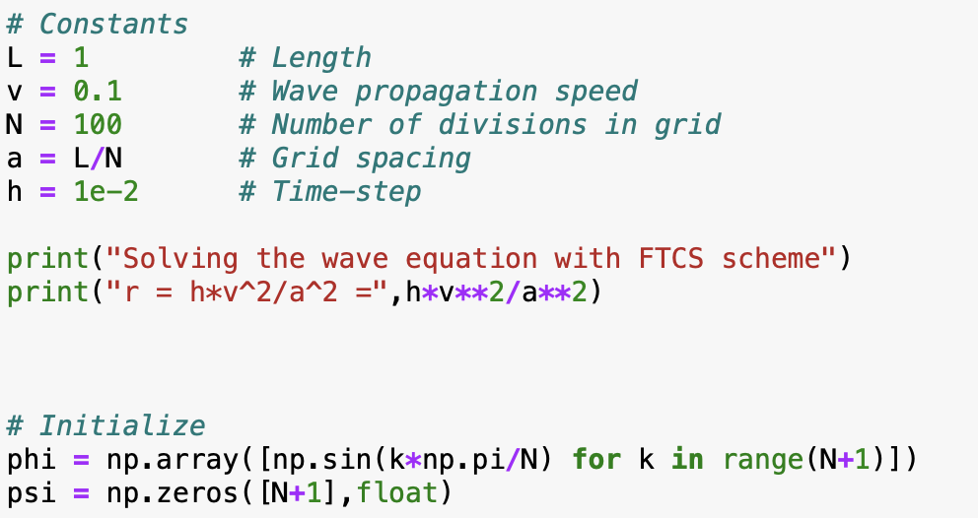
Wave equation
FTCS scheme is unstable

Slide 26
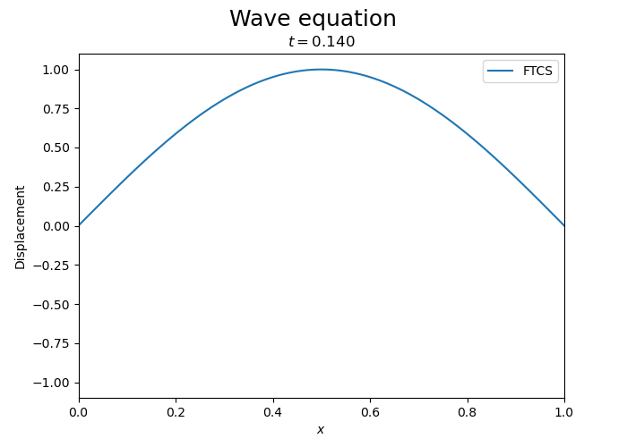
Wave equation
FTCS scheme is unstable

Slide 27
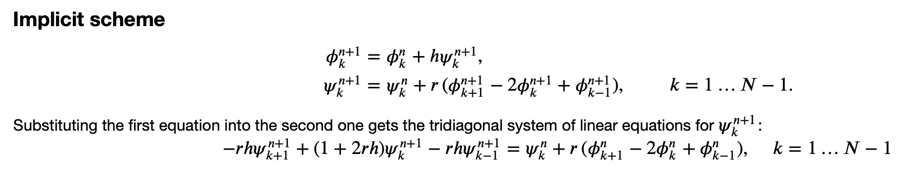
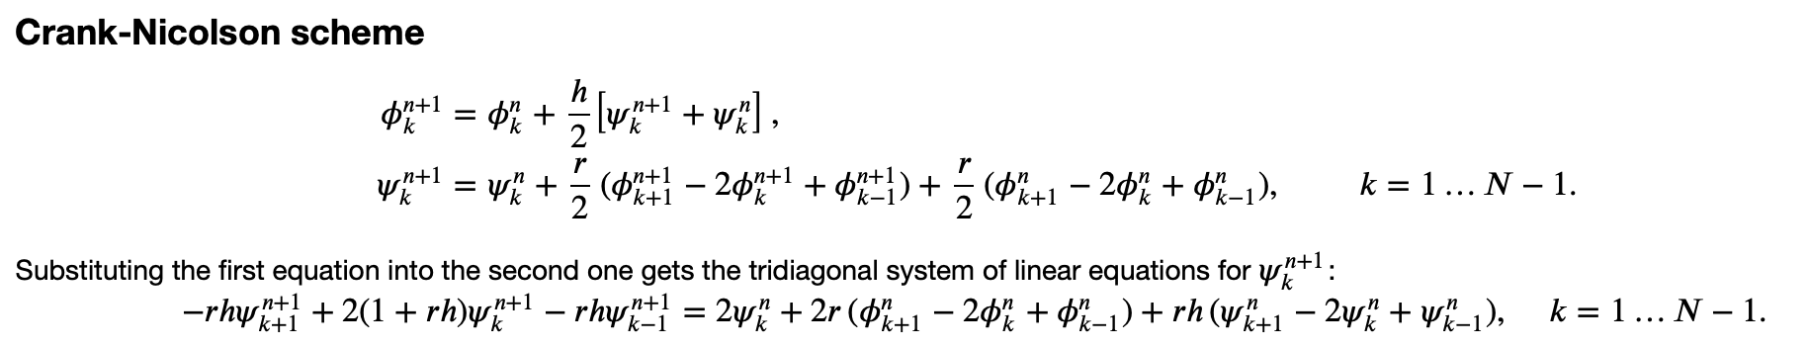
Wave equation: other schemes
Stable, but has exponential decay (waves don’t propagate forever)
Stable, no growth or decay

Slide 28
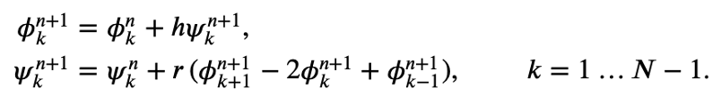

Wave equation: other schemes
Implicit Scheme
Substituting the first equation into the second one gives the tridiagonal system of linear equations for $ψ_{k}^{n+1}:$
Stable, but has exponential decay (waves don’t propagate forever)
Crank-Nicolson Scheme
Substituting the first equation into the second one gets the tridiagonal system of linear equations for $ψ_{k}^{n+1}$:
Stable, no growth or decay

Slide 29

Wave equation with Crank-Nicolson scheme

Slide 30

Wave equation: Comparison

Slide 31

Wave equation: Pulses

Slide 32

Wave equation: Pulses

Slide 33
Summary
Scheme | Complexity | Stability | Accuracy
FTCS | Explicit | Heat eq.: Conditionally stable Wave Eq.: Unstable | Exponential explosion
Implicit | Tridiagonal SLE | Stable | Exponential decay
Crank-Nicholson | Tridiagonal SLE | Stable | Conserves wave amplitude

